Slide 1

Fourteenth International Conference on Sport & Society Women Leadership in Sport: Trinidad & Tobago Amara Felix-Toussaint UNIVERSITY OF THE WEST INDIES, TRINIDAD & TOBAGO amara.felix@my.uwi.edu
Notes:
Good Morning all,
My name is Amara Felix Toussaint
A Phd Student Salises
It is a pleasure to be able to present my current research with you
I would like to pose some questions to the audience and you don’t have to answer out loud
Think about What are some of the more popular sports in our the region?
Who recall by name any women who sits on the board of that sport?
What about right here in Trinidad & Tobago
In cricket? In football? Basketball?
Now these are the questions that have founded the basis of my research

Slide 2
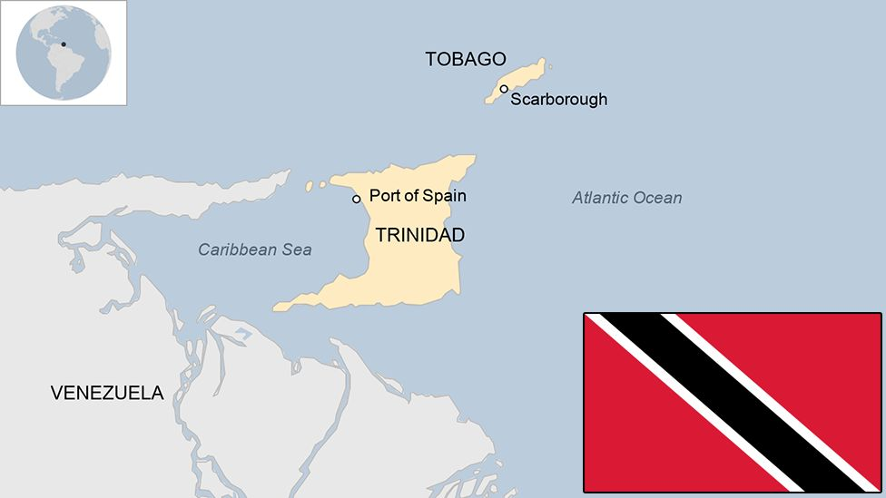
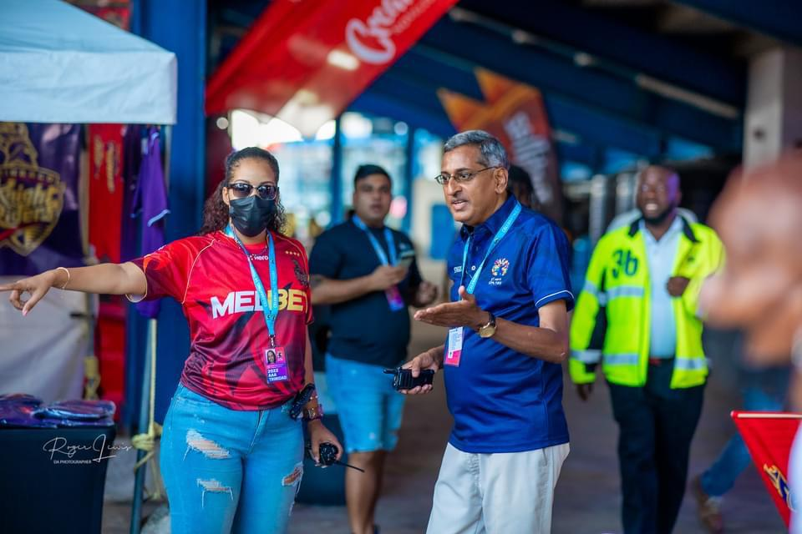
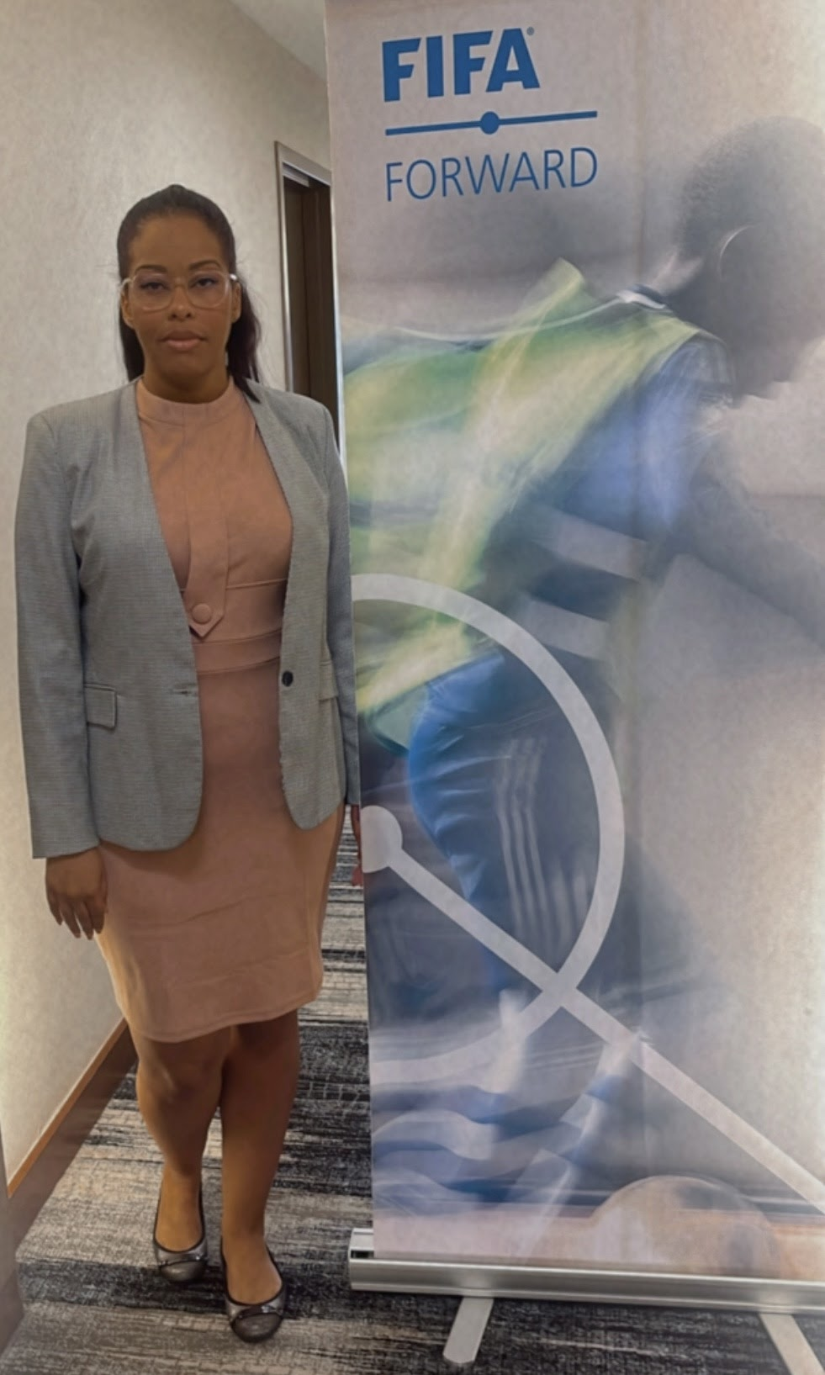
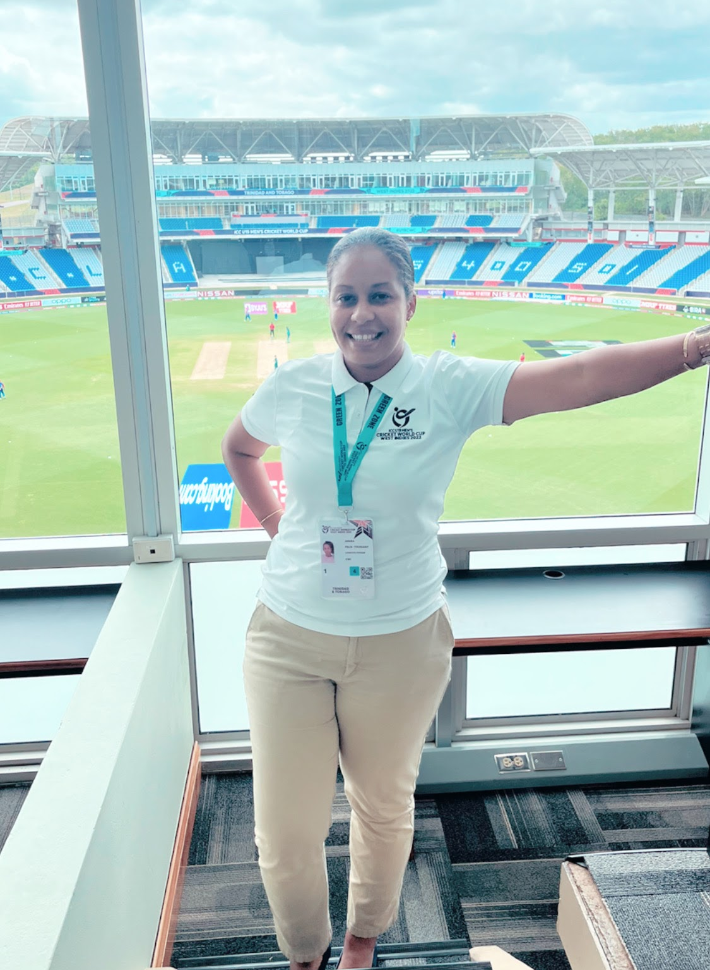
INTRODUCTION
Trinbagonian
Board Member -Trinidad and Tobago Cricket Board
Ticketing Manager – Trinbago Knight Riders
Club Licensing – Trinidad & Tobago Football Association
FIFA Forward Project -Trinidad & Tobago Football Association
PhD Candidate – University Of The West Indies
n

Slide 3
ABSTRACT
Keywords ;
Leadership, Sport, Caribbean, Gender, Inequality
In my personal experience as a female sport administrator the number of women working in sport has increased but those who transcend to top leadership positions are restricted.
The United Nations Women Count report states that “greater investment in gender statistics is vital, since less than half of the data required to monitor Goal five are currently available”.
The purpose of this current research is to highlight the experiences of Women leaders in sport; and validate their experiences via open ended interviews and analyzed through the lens of the Hegemonic masculinity theory (Connell 1987, 1995).
There is currently a dearth in literature regarding women leadership in Caribbean sport. This would benefit the Caribbean region by yielding current research and igniting new perspectives on this contentious issue. This new data can be used to inform strategic appointments and decisions in sporting organizations in tandem with United Nations sustainable development goal five; gender equality and empower all women and girls.
Regionally the composition of national sporting bodies lacks female representation. The governing bodies for the two most popular sports in the English-speaking Caribbean; Cricket West Indies and CONCACAF both have two female amongst the male dominated board of directors.

Slide 4
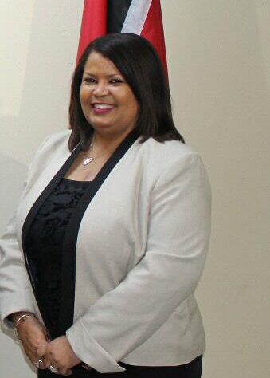
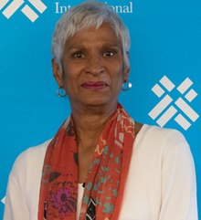
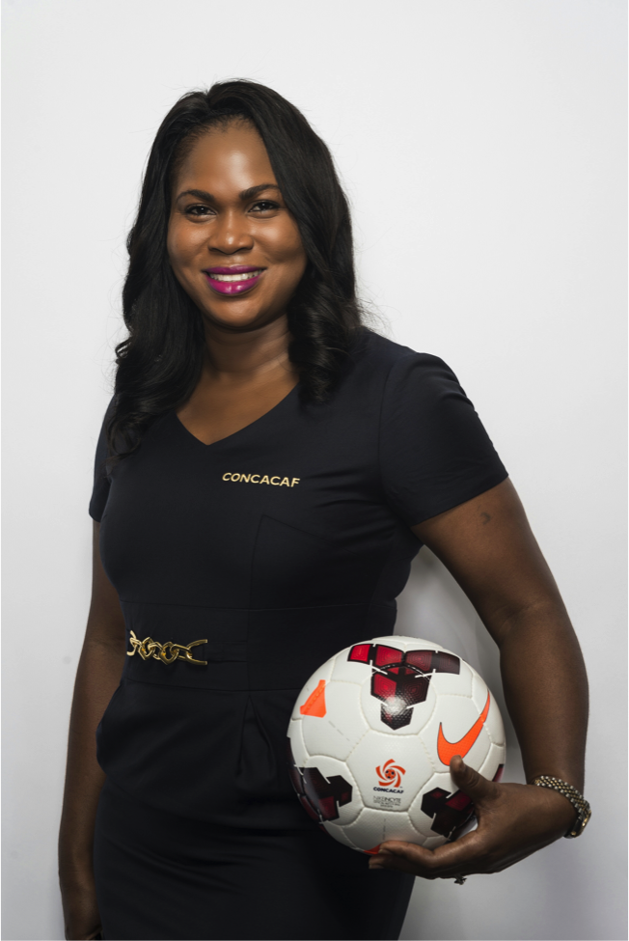
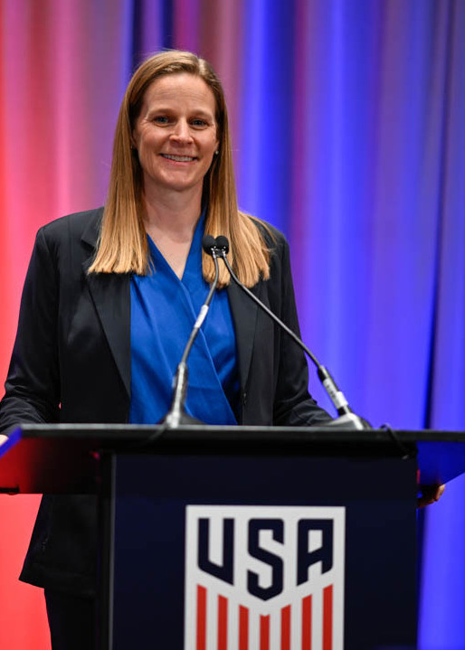


Regional Female Sport Directors
DEBRA CORYAT- PATTON GAIL MATHURIN
SONIA FULFORD MISSICK CINDY PARLOW CONE

Slide 5

RESEARCH OBJECTIVES
To explore the experiences of women leaders in sport in Trinidad and Tobago.
To find out the views of women leaders in sports as to how the sport industry can create a space for women to participate without structural and cultural obstacles.
Make recommendations to engender change at both the micro and macro level of sport organizations in Trinidad and Tobago.

Slide 6
REVIEW OF LITERATURE
Throughout history women have been stereotyped as being the less intellectual and weaker sex (Cohen & Huffman, 2007).
The under representation of women in leadership levels is fostered by the gendered organizational culture (Burton, 2015).
‘Men initially organized modern sport for men and leadership positions in sport were first held exclusively by men... thus both sport and positions within it were constructed on the basis of what was meaningful and important to men’ (Claringbould and Knoppers 2012)
Even with the increase in female participation in sports, fewer women occupy positions of decision making in sports organizations (Simmons 2011).
While “gender quotas may increase the statistics of women on boards they may not contribute to meaningful change”, (Pfister 2010)

Slide 7
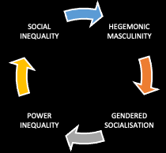
THEORETICAL FRAMEWORK
HEGEMONIC MASCULINITY THEORY - CONNELL 1987
A socially constructed form of masculinity that legitimates unequal gender relations between men and women, between masculinity and femininity.
Connell's theory of hegemonic masculinity is based on several key assumptions about gender, power, and social relations:
Masculinity is not innate or biologically determined, but rather learned and reinforced through socialization and cultural practices.
Masculinity is linked to power and dominance and is often associated with the subordination of women and other marginalized groups.
The construction and reinforcement of hegemonic masculinity is a dynamic and ongoing process, shaped by changing social and cultural contexts.

Slide 8
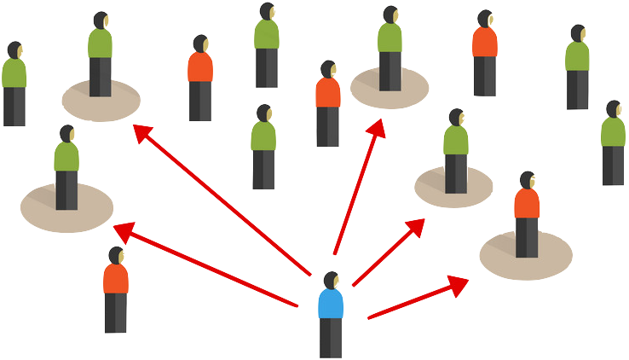

METHODOLOGY
SAMPLING & DATA COLLECTION
Purposeful sampling is a technique widely used in qualitative research for the identification and selection of information-rich cases for the most effective use of limited resources (Patton 2002). This method is often used in qualitative studies to represent the key attributes of the research (Denzin & Lincoln, 2011) and in this case it would be women in Leadership positions in sport from Trinidad and Tobago.
According to Creswell "this involves identifying and selecting individuals or groups of individuals that are especially knowledgeable about or experienced with a phenomenon of interest”, (Creswell & Plano Clark, 2011 ).
Interviews can be an empowering experience for women, as they are given the opportunity to share their perspectives and be heard; particularly for women who may feel marginalized or silenced in other contexts”(Tweed 2018).
Currently open-ended interviews are gaining more widespread acceptance as a research method because it can provide researchers with a richer account of events than larger scale, standardized statistical approaches because it focuses on meaning across a dataset .

Slide 9

METHODOLOGY
DATA ANALYSIS: THEMATIC ANALYSIS
Thematic analysis is a qualitative method used to identify common themes and patterns in women's experiences so that researchers can help to validate the experiences of women and provide a deeper understanding of the issues they face. This can help to inform policies and interventions that are designed to support and empower women.
"Thematic analysis is a method that allows for the identification of patterns or themes within qualitative data, making it particularly useful in the study of women's experiences”, (Braun and Clarke 2006).
Thematic analysis is used to ‘extract core reoccurring words and themes’ from within an individual’s account of their personal experiences” (Bryman 2012).

Slide 10
EMERGING THEMES
Theme 1
Theme 2
Theme 3
Theme 4
Theme 5
Theme 6
Culture Shifting
Gender Inequality and Discrimination
Glass Ceiling
Male Mentors
Participation in Decision Making
Work Life Balance

Slide 11

REFLEXIVITY
This study developed as a result of my experiences and reflections related to sport in Trinidad and Tobago.
Like many research projects, which evolve not just from identified ‘gaps’ in the literature, but also from topics that grab us and pique our curiosity (Braun & Clarke, 2009).
Reflective practice can be defined as “the ability to purposely explore personal experiences, beliefs or knowledge in order to increase understanding, promote personal growth and improve professional practice” (Hoang & Pretorius 2017).
The results will assist governments in formulating gender equality policies, such as targets and quotas in the future.
In addition to promoting equality between men and women, it can also impact board governance by bringing new ideas and perspectives to those boards (Adams & Ferreira, 2009) and allow an expanding diversity and inclusion culture on the board.

Slide 12

CONCLUSION
The pattern of male dominated leadership roles have been preserved through time. However there seems to be a shifting of culture and the outlook of sport leadership.
Men are viewed as the agents of change. However, it can be a contradiction that the key elements to foster change is males, since gender equity and sport is primarily looked upon as a question concerning girls and women (Connell 2003, Hargreaves and Anderson 2014).
Women reported that their opportunities came from referrals from their male superiors. Their male supervisor created the segue for women to elevate their career and position in their organization. This is means that men ironically , on a structural level, are accountable for and control the production and implementation of gender equity polices and initiatives.
Hopefully, the results from this study may offer a platform for future research development and hope for female leaders pursuing roles in sport. This research just merely scraped the surface as the real crux of the matter lies not only in the problem but the perpetuating of the issue and the policies or lack thereof that enforces the inequality.

Slide 13
REFERENCES
Braun, V., & Clarke, V. 2006. Using thematic analysis in psychology. Qualitative Research in Psychology, 3(2), 77–101. https://doi.org/10.1191/1478088706qp063oa
Braun, V., & Clarke, V. (2009). Special Issue: Coming out in higher education. Lesbian & Gay Psychology Review, 10(1), 3-69
Burton, Laura J., 2015. "Underrepresentation of women in sport leadership: A review of research," Sport Management Review, Elsevier, vol. 18(2), pages 155-165.
Claringbould, Inge & Knoppers, Annelies. (2012). Paradoxical Practices of Gender in Sport-Related Organizations. Journal of Sport Management. 26. 404-416. 10.1123/jsm.26.5.404.
Cohen, Philip N., and Matt L. Huffman. “Working for the Woman? Female Managers and the Gender Wage Gap.” American Sociological Review 72, no. 5 (2007): 681–704. http://www.jstor.org/stable/25472487.
Connell R. 1995. Masculinities. Cambridge, UK: Polity Press.
Connell R. 1987. Gender and Power. Sydney: Allen and Unwin.
Connell R., Messerschmidt J. W. 2005. “Hegemonic Masculinity: Rethinking the Concept.” Gender & Society 19: 829–859.
Creswell, J.W. and Plano Clark, V.L. 2011. Designing and Conducting Mixed Methods Research. 2nd Edition, Sage Publications, Los Angeles. Creswell. J.W. and Creswell, J.D. 2017. Research Design: Qualitative, Quantitative, and Mixed Methods Approaches. 4th Edition, Sage, Newbury Park.
Denzin, N. K., & Lincoln, Y. S. 2011. The SAGE Handbook of Qualitative Research. Thousand Oaks, CA: Sage.
Patton, M. Q. (2015). Qualitative research & evaluation methods: Integrating theory and practice (4th ed.). Thousand Oaks, CA: Sage.
Pfister G. (2010) Women in sport – gender relations and future perspectives , Sport in Society, 13:2, 234-248, DOI: 10.1080/17430430903522954
Simmons, Katie. 2011. “Women in Top Management Positions in the Sport Industry: Breaking Down the Barriers and Stereotypes.” St. John Fisher College. http://fisherpub.sjfc.edu/cgi/viewcontent.cgi?article=1031&context=s port_undergrad
Tweed, Carla. 2018. "Women in Leadership, in a Male-Dominated Field, Specifically the California Highway Patrol" . Dissertations. 179.

Slide 14
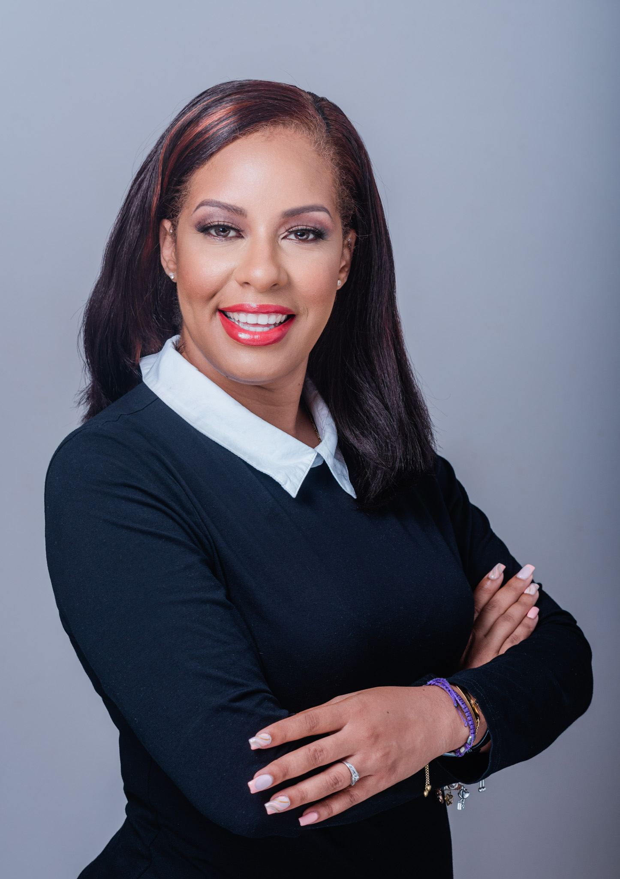




THANK YOU
Amara Felix-Toussaint
PhD. Candidate
(Governance)
University Of The West Indies
St. Augustine
Trinidad &Tobago
amara.felix@my.uwi.edu

