Slide 1

Bolstering Diversity and Inclusion through Learning Capacity Models: Changing Traditional Practices Make a Big Difference in Diversifying the Workforce
Donna Duellberg, EdD
Part I

Slide 2
Recruitment and Classification
AFQT scores are used to determined enlisted recruitment eligibility in the Armed Services.
The AFQT is derived from four ASVAB subsets (PC, WK, AR & MK)
ASVAB subsets are used to create minimum composite scores in order to qualify for rate classification & training
Expanded use of Waivers & minimums changed
Notes:
AFQT – Armed Forces Qualification Test (formula AFQT = 2VE +AR+MK)
ASVAB – Armed Service Vocational Aptitude Battery
History: Military used Aptitude Testing since WWI – Alpha and Beta Tests to help screen recruits. These tests were designed to assess verbal, numeric, follow directions, general knowledge info.
WWII modification made to test over 12M recruits…Army/Navy General Classification Tests plus supplemental tests
50’s – AFQT developed for a single use joint test; supplemented by classification test (test batteries)
1974 – ASVAB adopted. One test is now used for both screening and classification

Slide 3
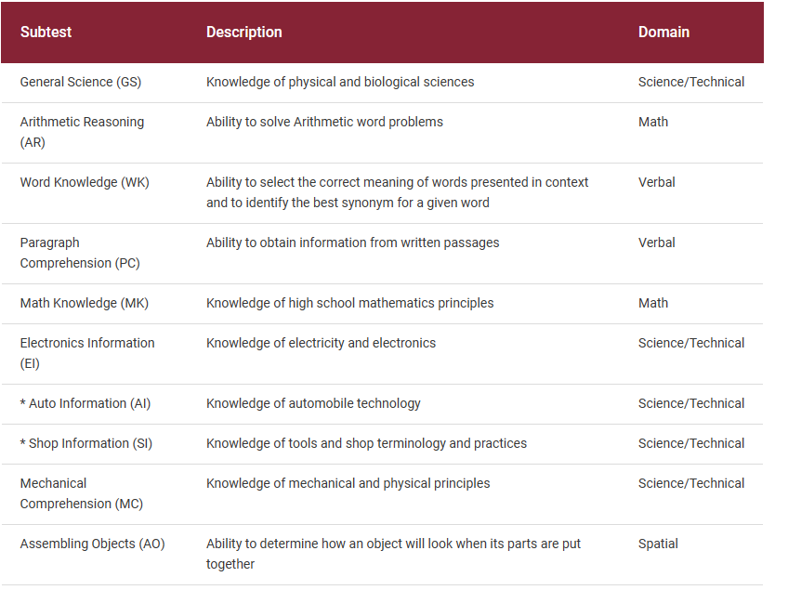
Armed Service Vocational Aptitude Battery subtests

Slide 4
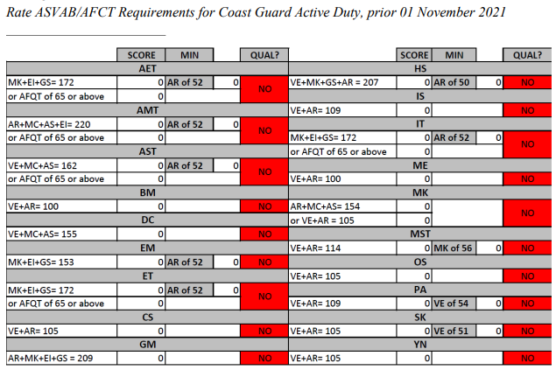
Rate Qualification

Slide 5
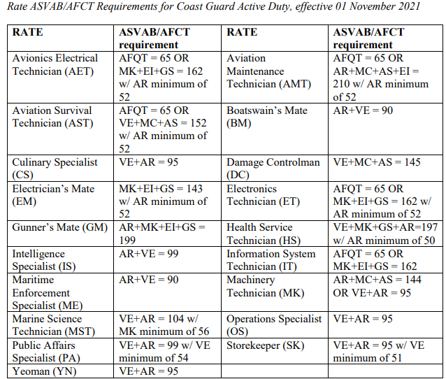
Rate Qualification

Slide 6
Diversity & Inclusion
Meeting the Composites

Slide 7
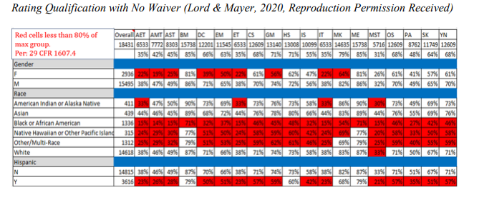
Rate Qualification with No Waiver

Slide 8
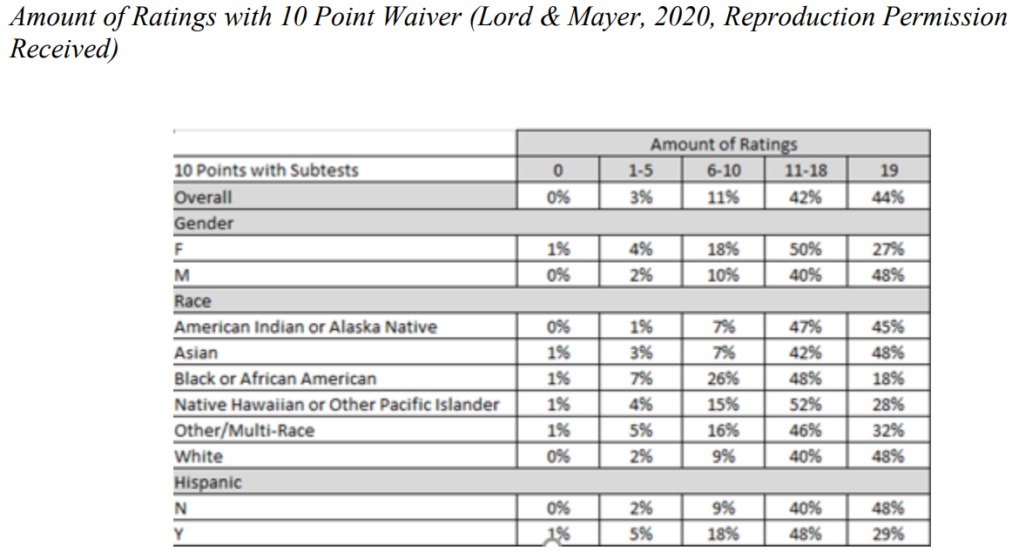
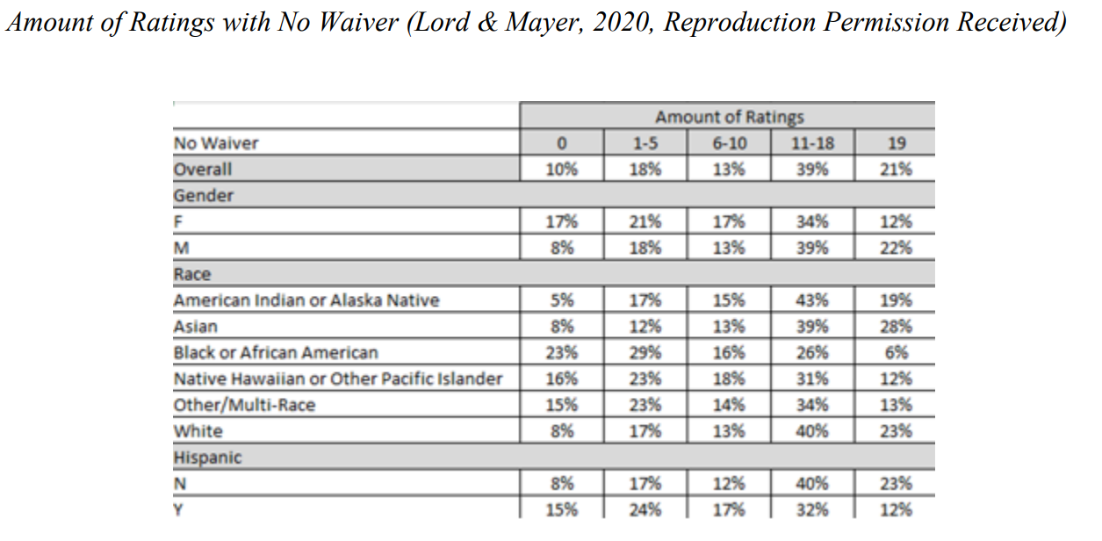
10 Point Reduction Alternative
Decreasing minimum composite cut-offs by 10 points across the Coast Guard OR if a 10-point waiver is in effect, would change the percentages favorably

Slide 9
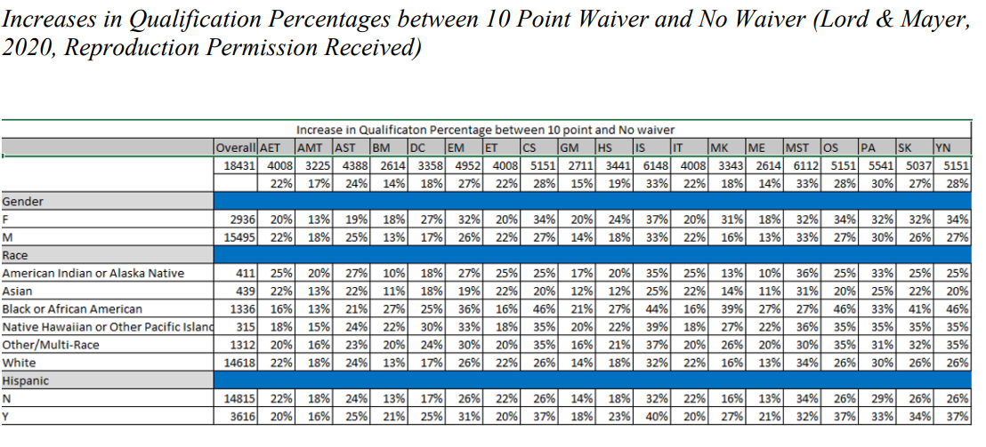
Qualification Percentages

Slide 10
The Alternative - Learning Capacity
Using multiple time-points of test scores to observe learning is referred to as dynamic measurement
Measuring in-between trajectory from multiple ASVABs provides learning capacity
When retesting, URMs improve their scores more relative to majority groups

Slide 11
Learning Capacity Advantages
URMs tend to select retesting over waivers
URMs improve their scores more than majority groups after retesting
Retesters have significantly lower recycling rates than waivers
Reduction in recycling for non-White retesters is even lower
Retesting & dynamic measurement is the recommended path to improving inclusivity and diversity in recruiting and selection

Slide 12
Bolstering Diversity and Leveraging Artificial Intelligence: Understanding Challenges and Cultural Differences in Diversifying the Workforce
Mary Ann Swendsen, CEM, MA, MS
Part II

Slide 13
Recruitment Discovery
During COVID-19 Pandemic, all services except Marine Corps increased end strength, decreased accessions and increased retention. There was an increase in quality of recruits
Closed recruiting offices and shifted to digital technology due to COVID-19, i.e, social media and virtual domain, increased applicants in the Delayed Entry Program but reexamine policies for banning individuals based on social media content
Uncertain impacts to military readiness and future impacts of vaccine mandates (entry & religious exemptions)
Adjusted recruitment goals for Active and Reserve force
In 2022, challenges include obesity, labor market and new health record system that screens for medical issues
Shift funding to recruitment initiatives and bonuses (Army $1.2 billion) due to youth eligibility disparities in requirements (decrease in previous years), societal demographic and health problems
Notes:
2022 RAND study, “What Happened to Military Recruiting and Retention of Enlisted Personnel in 2020 During the COVID-19 Pandemic?”
https://www.rand.org/pubs/research_reports/RRA1092-1.html
2020 CNA study, “The Impact of COVID-19 on Military Recruiting”
https://www.cna.org/our-media/indepth/2020/07/the-impact-of-covid-19-on-military-recruiting
https://time.com/6260526/army-recruitment-problem-us/

Slide 14
Recruitment Standards Change is needed
Academic performance and physical health barriers including marijuana use (depending on state laws)
SAT/ACT scores - no longer requirement by colleges, high students opt out on taking tests
Diversity groups across services have tested below the ASVAB standards and waivers implemented
Recruitment quota per recruiter/month have decreased while there is an increase in potential recruits
Recruitment tactics developed to increase women to 30% by 2030
Notes:
Communities that are deprived from and/or have significant differences in meeting high school academic standards along with access to healthy products via food supply chain (what’s served/food options in public versus private schools?)

Slide 15

Leveraging Artificial Intelligence & Machine Learning (AI/ML)
Bridge
Bridge the gap between open source information about potential recruits and DoD services recruitment database
Evaluate
Evaluate current lateral change in rating and lateral entry requirements
Provide
Provide insights on the effectiveness of aptitude testing and professional development of military members
Modernize
Modernize testing of recruits and military members for continued educational opportunities
Assess
Assess ASVAB test scores, retesting and learning capacity advantages
Validate
*Validate Donna’s presentation on Dynamic Measurement Modeling (DMM) and learning capacity assessment
Notes:
Donna’s Learning Capacity Advantages recommendation to “Retesting & dynamic measurement is the recommended path to improving inclusivity and diversity in recruiting and selection.”
Lateral rate change/entry – Dive rating, investigative rating (dive experience / detective experience)

Slide 16
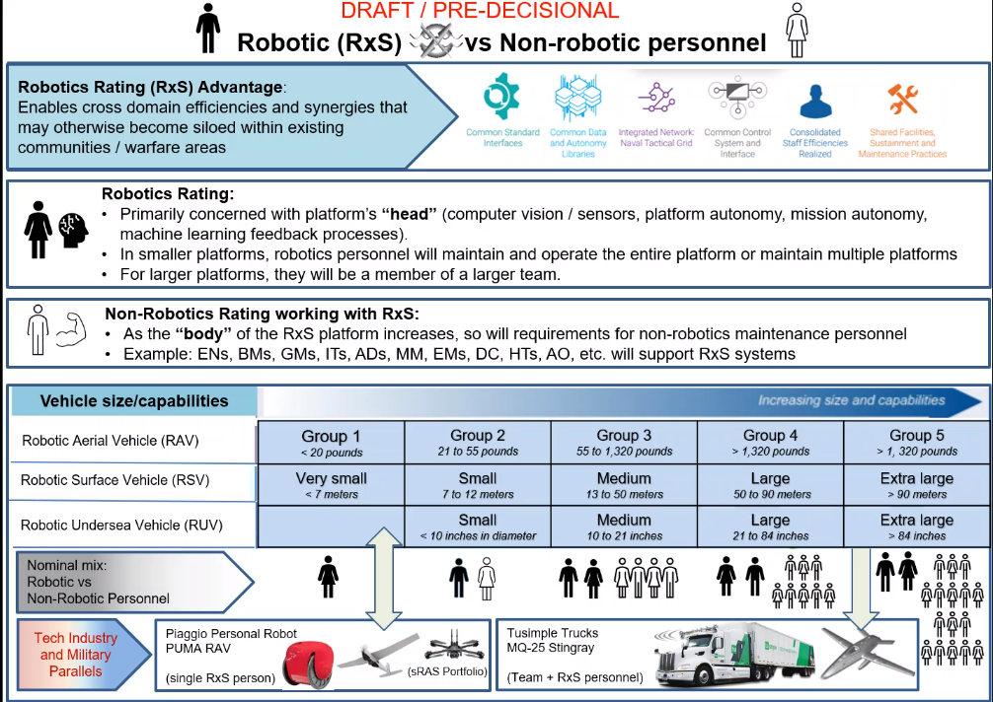
Robotic Rating Example

Slide 17
Cultural Aspects for Inclusion to a Diverse Workforce
How to bridge the gap between diversity and organizational effectiveness?
Diverse demographics vs diverse skills, capabilities & competencies
Enhance military effectiveness
Significant opportunities for leveraging workforce diversity
Enhance capacity for innovation and quality of decision-making
Improve engagement with partners and allies
Improve ability to attract, retain and foster skills needed
Strategic enabler
Recruit, manage and reward
Increase organizational capability
Neurodiversity – common strengths valued but not accommodated
Notes:
https://www.rand.org/blog/2022/08/removing-barriers-to-diversity-and-inclusion-in-the.html
https://www.rand.org/pubs/research_reports/RRA1026-1.html
https://www.rand.org/pubs/research_reports/RRA1875-1.html
Neurodiversity, like other forms of diversity, can strengthen a national security organization
Common strengths among the neurodivergent population include pattern recognition, analysis, visualization, problem-solving, memory, and achieving a state of hyperfocus to complete a project—skills that can be beneficial in many fields of interest to national security.

Slide 18
Recruiting Challenges
Increase outreach and command community efforts post COVID-19, “war for talent” requires “whole-of-force effort”
Organizational incentives and leader evaluations to reflect diverse workforce needs…pilot programs mirror industry
Security clearance and financial suitability
Administrative policies (i.e., tattoo, age, health, and drug use)
Disparities that were discovered post COVID-19
Lack of social support and links to mental health
Impacts to academic performance
Access to digital technology
Notes:
Less than 1% of the U.S. population is a military member, hence, no personal connections to understand military life and its opportunities (survey>barrier).
https://time.com/6260526/army-recruitment-problem-us/

Slide 19
Pacific Islander Regional Challenges
Citizenship (Green card), i.e., Guam is a U.S. Territory
Recruiter assignment and office locations
Coordination of medical and testing facilities for potential recruits
Testing methods (paper vs. digital) and scores
Physical requirement barriers
Access to digital world and infrastructure
“Leaving the island” syndrome
Notes:
Green card – permanent resident, allows to work in U.S.
Guam is a U.S. territory and are treated as U.S. citizens
American Samoans are U.S. nationals vs. citizenship legal issues on-going
Fly to medical and testing facilities
BMI is based on height and weight
Lack of free internet and access to computers, phone, internet café/establishments

Slide 20
Potential AI/ML Opportunities
Current AI use in recruitment
On-line interviews, video and resume submissions, etc.
New emerging needs
Robotics rating
Assessing future workforce needs
Trustworthy AI systems – mitigate negative risks and contribute to benefits
AI lifecycle stages
Government Responsible AI & Implementation Pathway, NIST AI Risk Management Framework, Metadata Guidance
Aligning evolving mission needs to diverse workforce needs
Notes:
Responsible AI & Implementation Pathway - DoD Responsible AI Working Council in accordance with the memorandum
issued by Deputy Secretary of Defense Kathleen Hicks on May 26, 2021, Implementing Responsible Artificial Intelligence in the Department of Defense. June 2022
National Institute of Standards and Technology (NIST) AI 100-1, AI Risk Management Framework (AI RMF 1.0)
https://doi.org/10.6028/NIST.AI.100-1
Department of Defense Metadata Guidance (Version 1.0 / Jan 2023) Memo from CDAO, Dr. Craig H. Martell dated 13Mar2023.

Slide 21
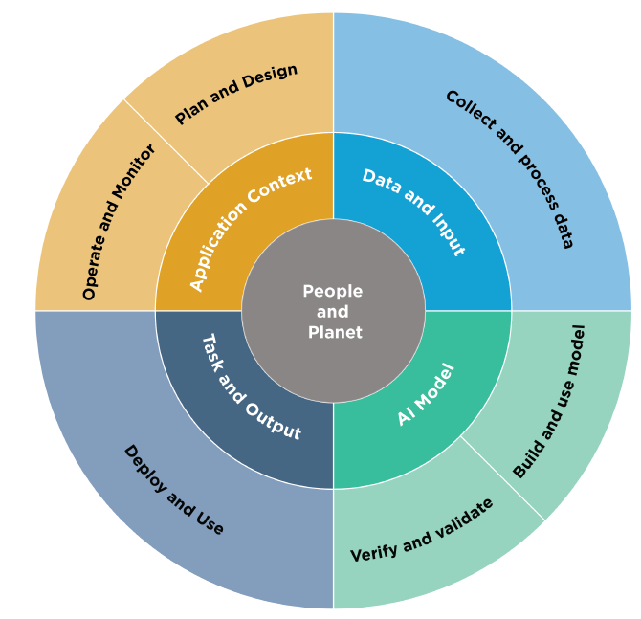
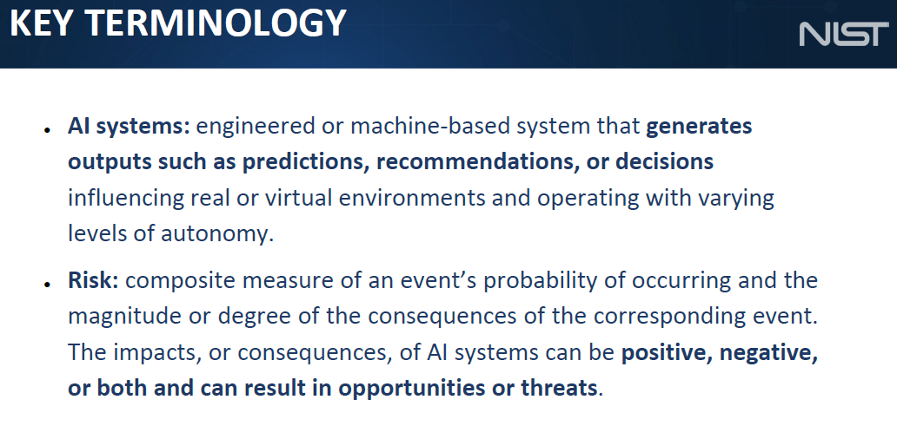
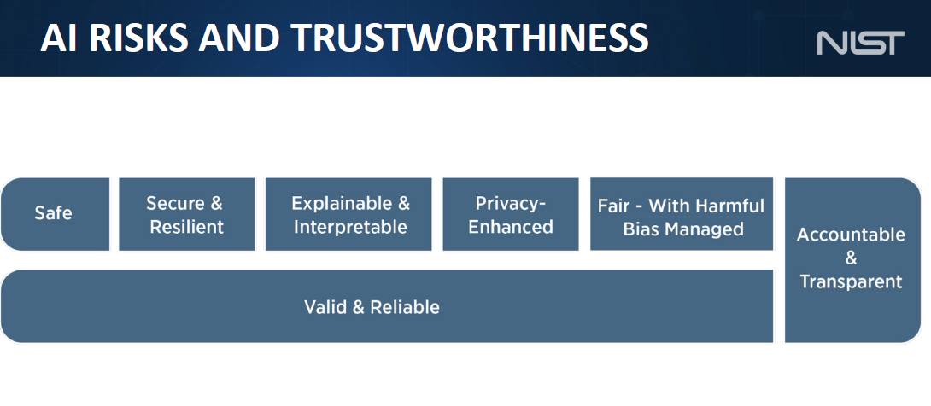
AI Risk Management Framework

Slide 22
Further Research & Investigation Will Test Scores Really Matter?
Use case development
ChatGPT
Cognitive warfare vs talents
Explore hybrid methods and models
Factors and considerations
Privacy and HIPA issues
Data standards and integrity
Validation of models (Bias coding, ethical standards/policies)
Continuous assessments
Cultural and moral measures
What is success in recruitment “today” vs “to be”
Notes:
PII stands for “personally identifiable information.” That term refers to information about a private individual that is part of that person's identity. PII compliance means that an IT system complies with one of the many standards that are currently in circulation that dictate how private data should be protected.
The Health Insurance Portability and Accountability Act of 1996 (HIPAA) is a federal law that required the creation of national standards to protect sensitive patient health information from being disclosed without the patient's consent or knowledge.

