Slide 1
Levels of depth on critical thinking
by Prof. Luís Fernando Pacheco Pérez

Slide 2

Warning All what you say and think about today’s topic is a paradigm-shifting approach.
There is no
correct answer
All answers
are correct

Slide 3
What is critical thinking anyways?
Does anyone have the competence to critically think?
Can critical thinking be taught?
Is it strictly bound to pedagogy?

Slide 4
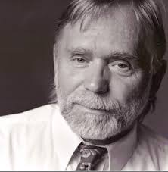
“Critical thinking is the art of thinking about thinking in an intellectually disciplined manner…they [critical thinkers] analyze thinking, they assess thinking, and they improve thinking (Paul, 2005).”

Slide 5
Discourse and power Reflective practice Critical discourse analysis
Michel Foucault
Donald Schön
Teun
van Dijk

Slide 6
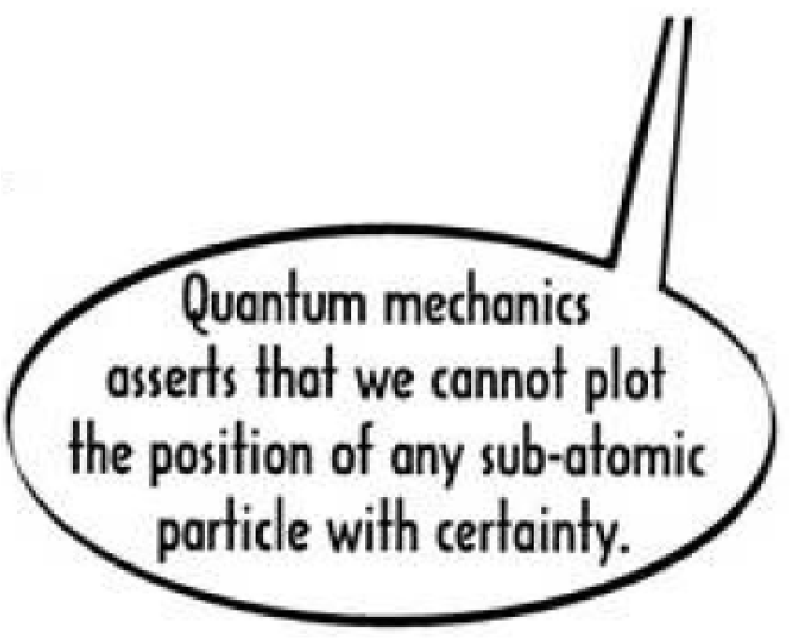
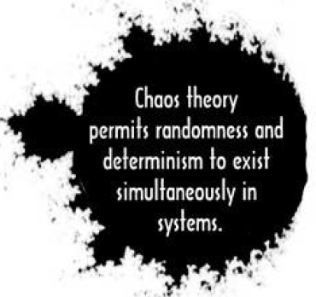
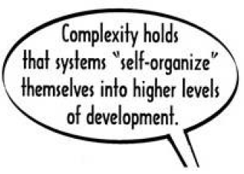
Introducing
Critical Theory: A graphic guide

Slide 7
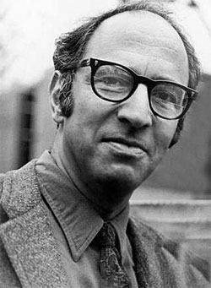
Pre-science
Normal science
Model drift
Model crisis
Model revolution
Paradigm change
Thomas Kuhn’s Paradigm Cycle

Slide 8
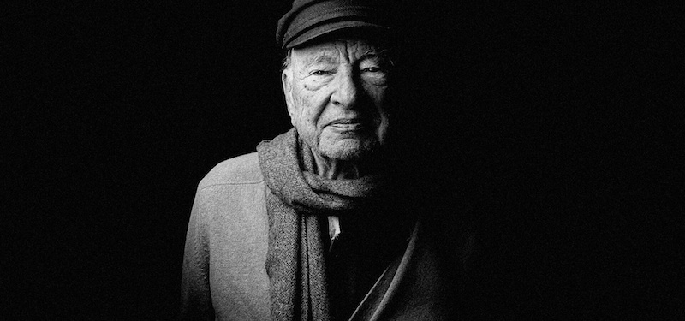
Being critical is being political
Edgar Morin’s Complexity Theory
Are Universidad del Quindío’s students political?

Slide 9
LEVELS OF DEPTH ON CRITICAL THINKING
Fixed one-dimensional C.T.
Fixed multi-dimensional C.T.
Dynamic multi-dimensional C.T.
Dynamic trans-dimensional C.T.

Slide 10
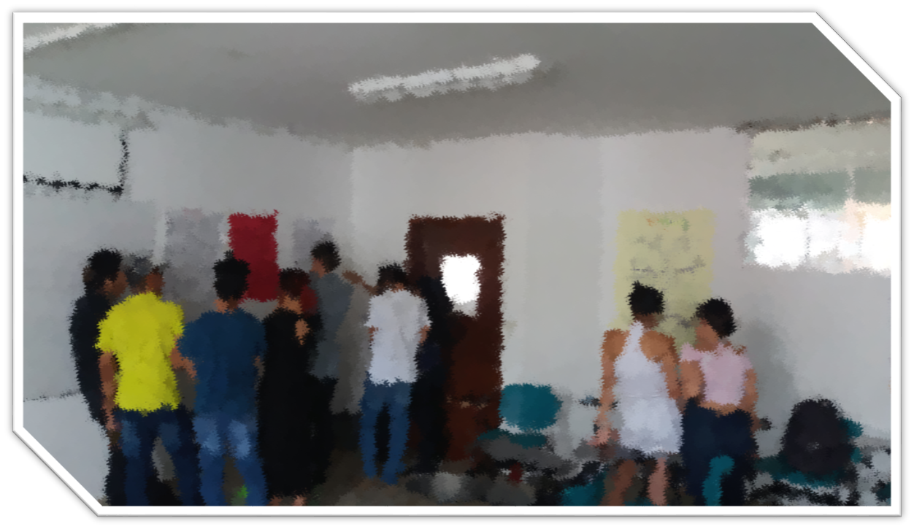
PLAN OF ACTION
Intercultural Context
Based Approach
(Pacheco. 2021)

Slide 11
DATA ANALYSIS Participants: 37 students from second semester (day and night SHIFT)
Weelky sessions: 1
Duration: 4 months

Slide 12
DATA ANALYSIS
Individual and cooperative discourse construction constantly improved.
Students’ discourse is more creative, abstract, dynamic and multidimensional when critical analysis is done in groups.
Student’s discourse is more fixed, more rational and, most of the times, multidimensional when critical analysis is done individually.
Levels of abstraction and multidisciplinary/ trans-disciplinary thinking drastically evolved.

Slide 13
CONCLUSIONS
The pedagogical implications were witnessed in terms of:
Tensions between personal and social discourse promote in students a construction of trans-dimensional discourses.
Students understand, through C.T-centered classes, that their experience and social schemata is imperatively important for their academic development.
The acknowledgement of the cultural-political traits of any given phenomenon of study as a fundamental part of a complete analysis becomes highly important in every student’s participation.
Code-switching processes do not limit students’ discourse edification.

Slide 14

Critical thinking, linked to language development, permits an unconscious process of meaningful learning.
El conocimiento es al hombre como el viento a la marea

